Slide 1
CasaLingua: Making Bloom More Accessible
Created By: Arnulfo Gonzalez Jr, Danny Newton, EmJ Webb, James Wilson, Kyle Frese
Created For: Exygy, Justice Through Code

Slide 2

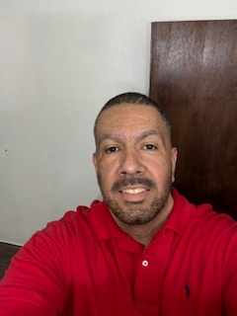

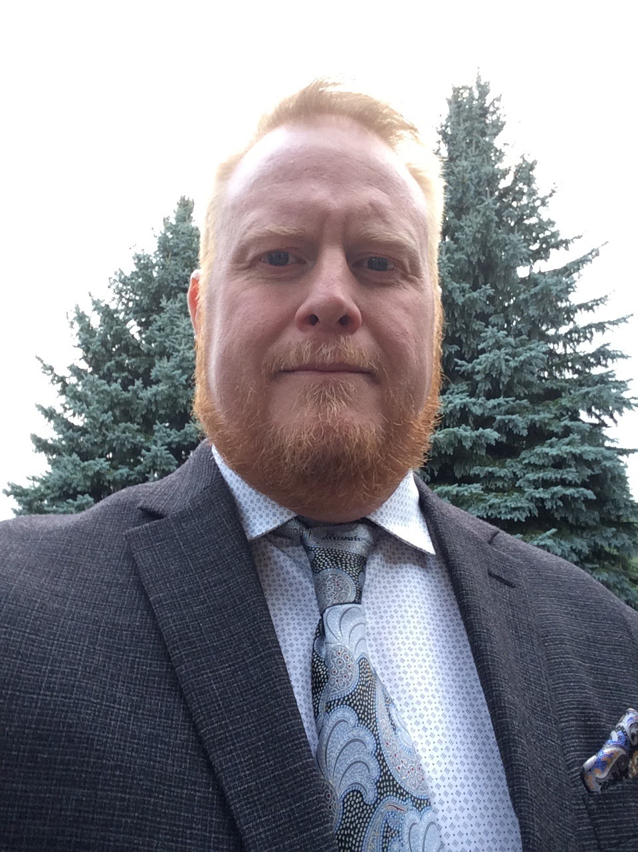


Meet The Team
Dan Newton Programmer, musician, and problem solver with a background in military communications and full-stack development. Focused on impactful tech projects like ILARJ and Exygy Bloom Housing. Skilled, adaptable, and always ready to collaborate—with code or a bass guitar.
Arnulfo Gonzalez Jr. Enthusiastic full-stack developer passionate about learning and building. Always eager to tackle new challenges, collaborate, and grow my skills in software development and problem-solving.
EmJ Webb Passionate MERN stack developer focused on using tech to transform lives. With skills in React, JavaScript, and team collaboration, she brings insight, humility, and a strong drive to learn and grow. Her mission: to serve, empower, and build through code
Our team brings together developers from a diverse background with the same mission in mind: make affordable housing more accessible for all.
James Wilson I solve complex rail industry problems by combining hands-on field experience with software solutions. With a background in quality leadership and software engineering, I streamline diagnostics, reduce non-conformances, and build real-time dashboards that drive smarter, safer decisions.
Kyle Frese Results-driven product and project manager with diverse background in tech and non-tech fields delivering projects on time and within budget. Equally passionate about providing platforms for impacted communities to be given every chance to succeed.

Slide 3

What We Are Trying to Address
CasaLingua is a revolutionary AI-powered platform that transforms complex housing documents into clear, accessible language while maintaining legal accuracy across multiple languages.
How it Works
Our dual AI architecture combines specialized simplification and translation engines, both trained specifically on housing documentation and policies. Unlike general-purpose language tools, CasaLingua understands the nuances of housing terminology across jurisdictions and languages.

Slide 4





Plan for product launch
Planning
Marketing
Design
Strategy
Launch
Synergize scalable e-commerce
Disseminate standardized
metrics
Coordinate
e-business applications
Foster holistically superior methodologies
Deploy strategic networks with compelling
e-business needs

Slide 5
Plan for product launch
Planning
Marketing
Design
Strategy
Launch
Synergize scalable
e-commerce
Disseminate standardized metrics
Coordinate
e-business applications
Foster holistically superior methodologies
Deploy strategic networks with compelling
e-business needs

Slide 6
Timeline
Nov 20XX
May 20XX
Disseminate standardized metrics
Deploy strategy networks with compelling e-business needs
Sep 20XX
Synergize scalable
e-commerce
Jan 20XX
Mar 20XX
Coordinate e-business applications
Foster holistically superior methodologies

Slide 7

Areas of focus
B2B market scenarios
Cloud-based opportunities
Develop winning strategies to keep ahead of the competition
Capitalize on low-hanging fruit to identify a ballpark value
Visualize customer directed convergence
Iterative approaches to corporate strategy
Establish a management framework from the inside

Slide 8



How we get there
ROI
Envision multimedia-based expertise and cross-media growth strategies
Visualize quality intellectual capital
Engage worldwide methodologies with web-enabled technologies
Niche markets
Pursue scalable customer service through sustainable strategies
Engage top-line web services with cutting-edge deliverables
Supply chains
Cultivate one-to-one customer service with robust ideas
Maximize timely deliverables for real-time schemas

Slide 9


Summary
At Contoso, we believe in giving 110%. By using our next-generation data architecture, we help organizations virtually manage agile workflows. We thrive because of our market knowledge and great team behind our product. As our CEO says, “Efficiencies will come from proactively transforming how we do business.”

Slide 10




Thank you
Mirjam Nilsson
mirjam@contoso.com
www.contoso.com

